Slide 1
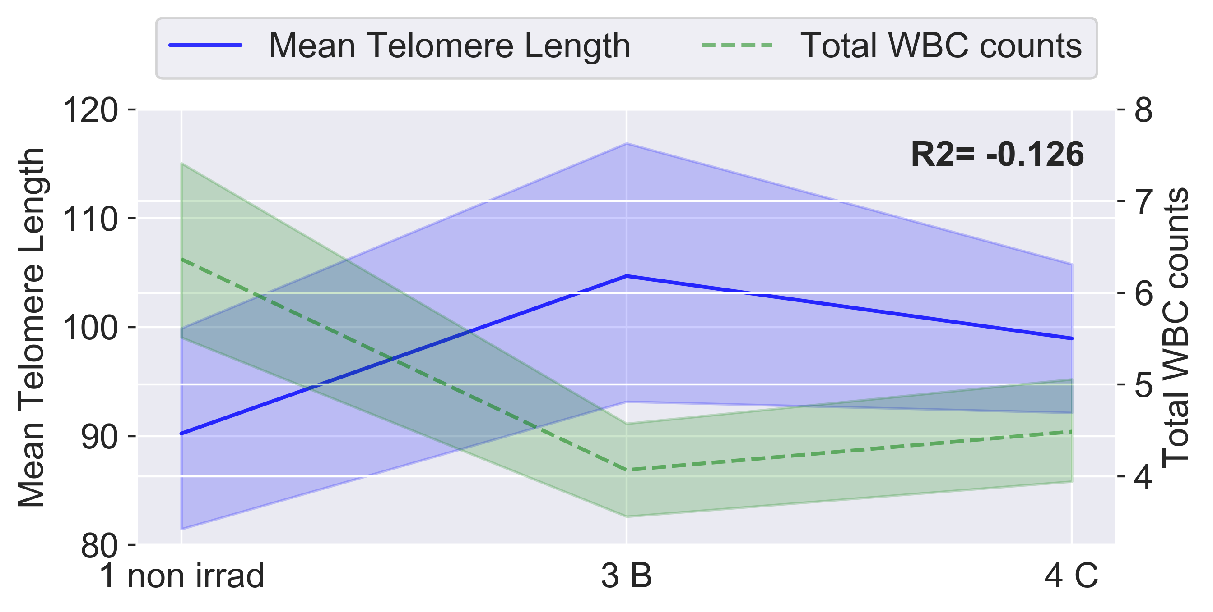
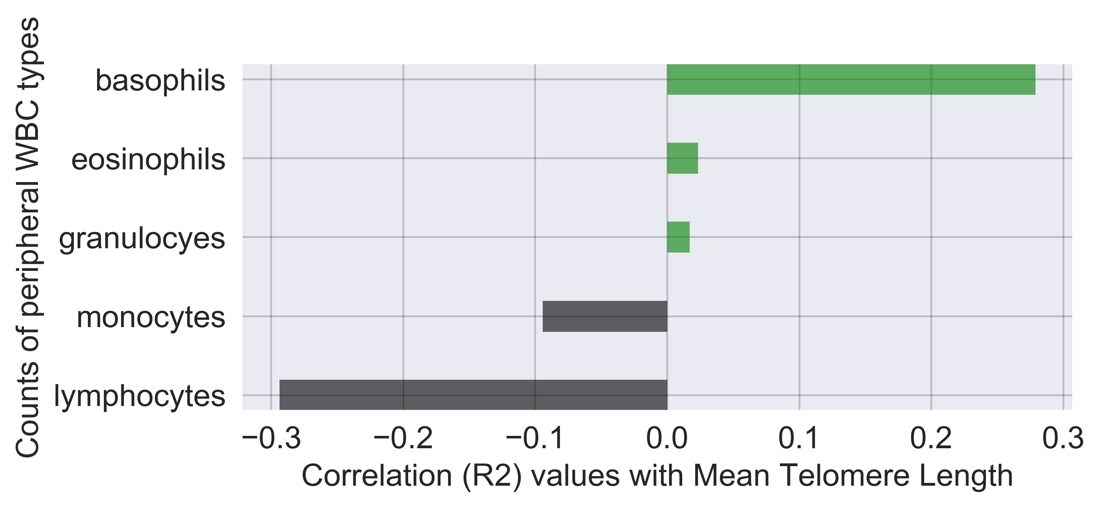
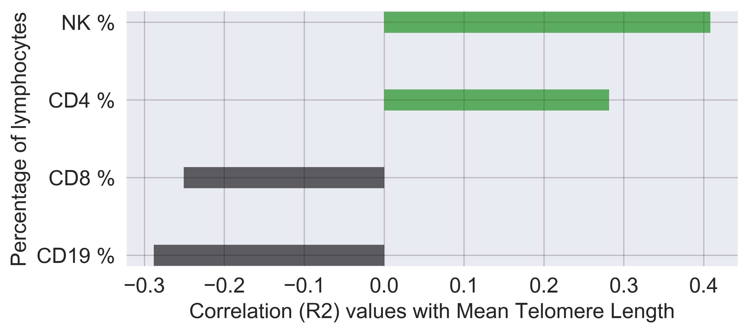
A
B
C
Notes:
SUPPLEMENTARY Fig 1 Longitudinal correlations between telomere length, peripheral white blood cells, and lymphocytes during IMRT. Mean telomere length plotted longitudinally against peripheral white blood cell (WBC) counts (thousands per microliter) from complete blood count tests for all patients; and longitudinal correlations between mean telomere length and counts of WBC types, and proportions of lymphocyte cell types. 1 non irrad: pre-therapy non-irradiated; 3 B: immediate post-therapy; 4 C: 3 months post-therapy. Pearson correlation R2 values were calculated between longitudinal values, as shown bolded in (A), on a per patient basis. Correlations between mean telomere length and WBC counts (A); center lines denote medians, lighter bands denote confidence intervals. Correlations between mean telomere length and five main WBC types (B), and proportions of lymphocyte cell types (C).

Slide 2
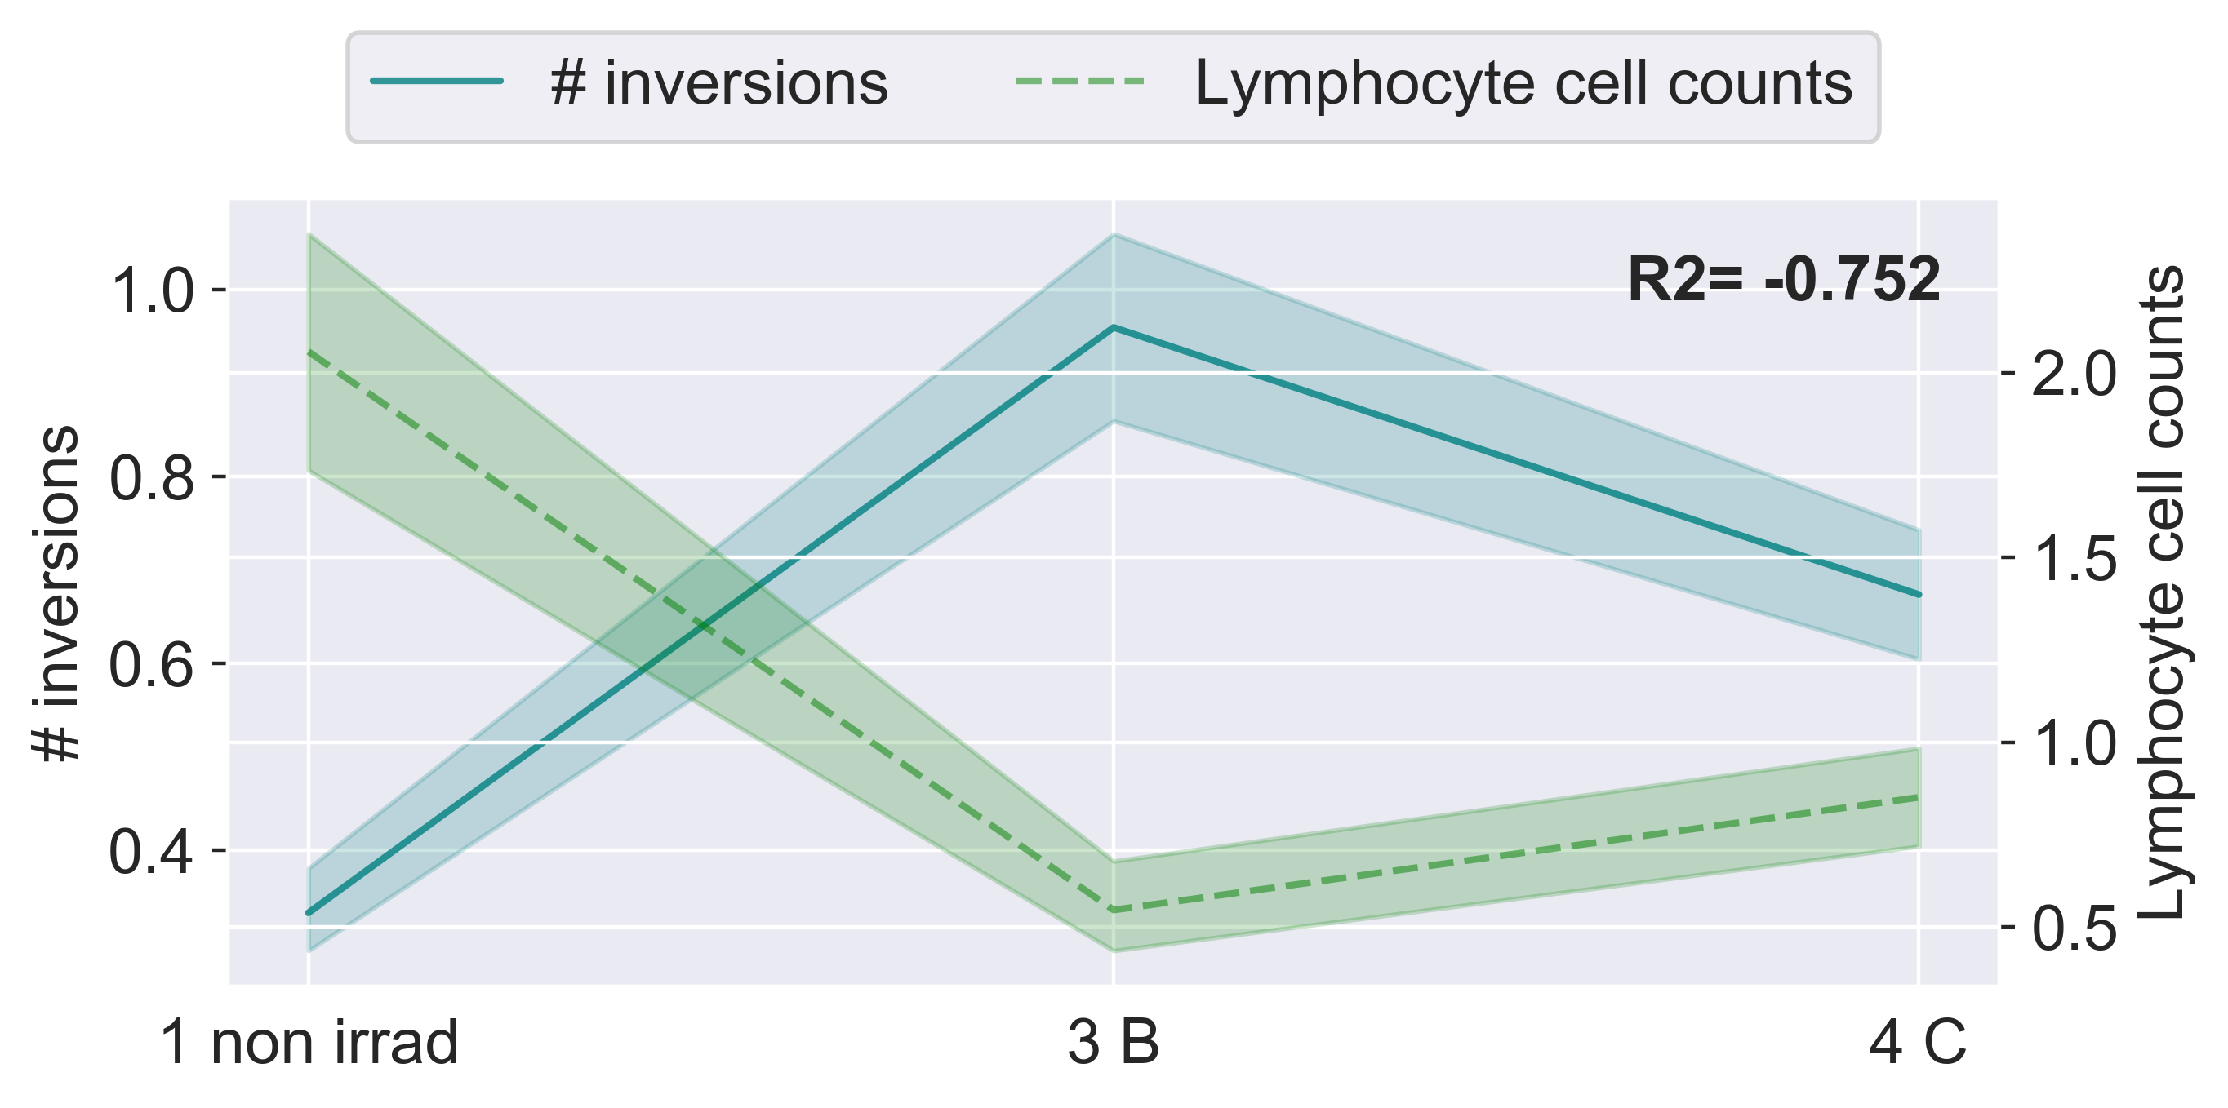
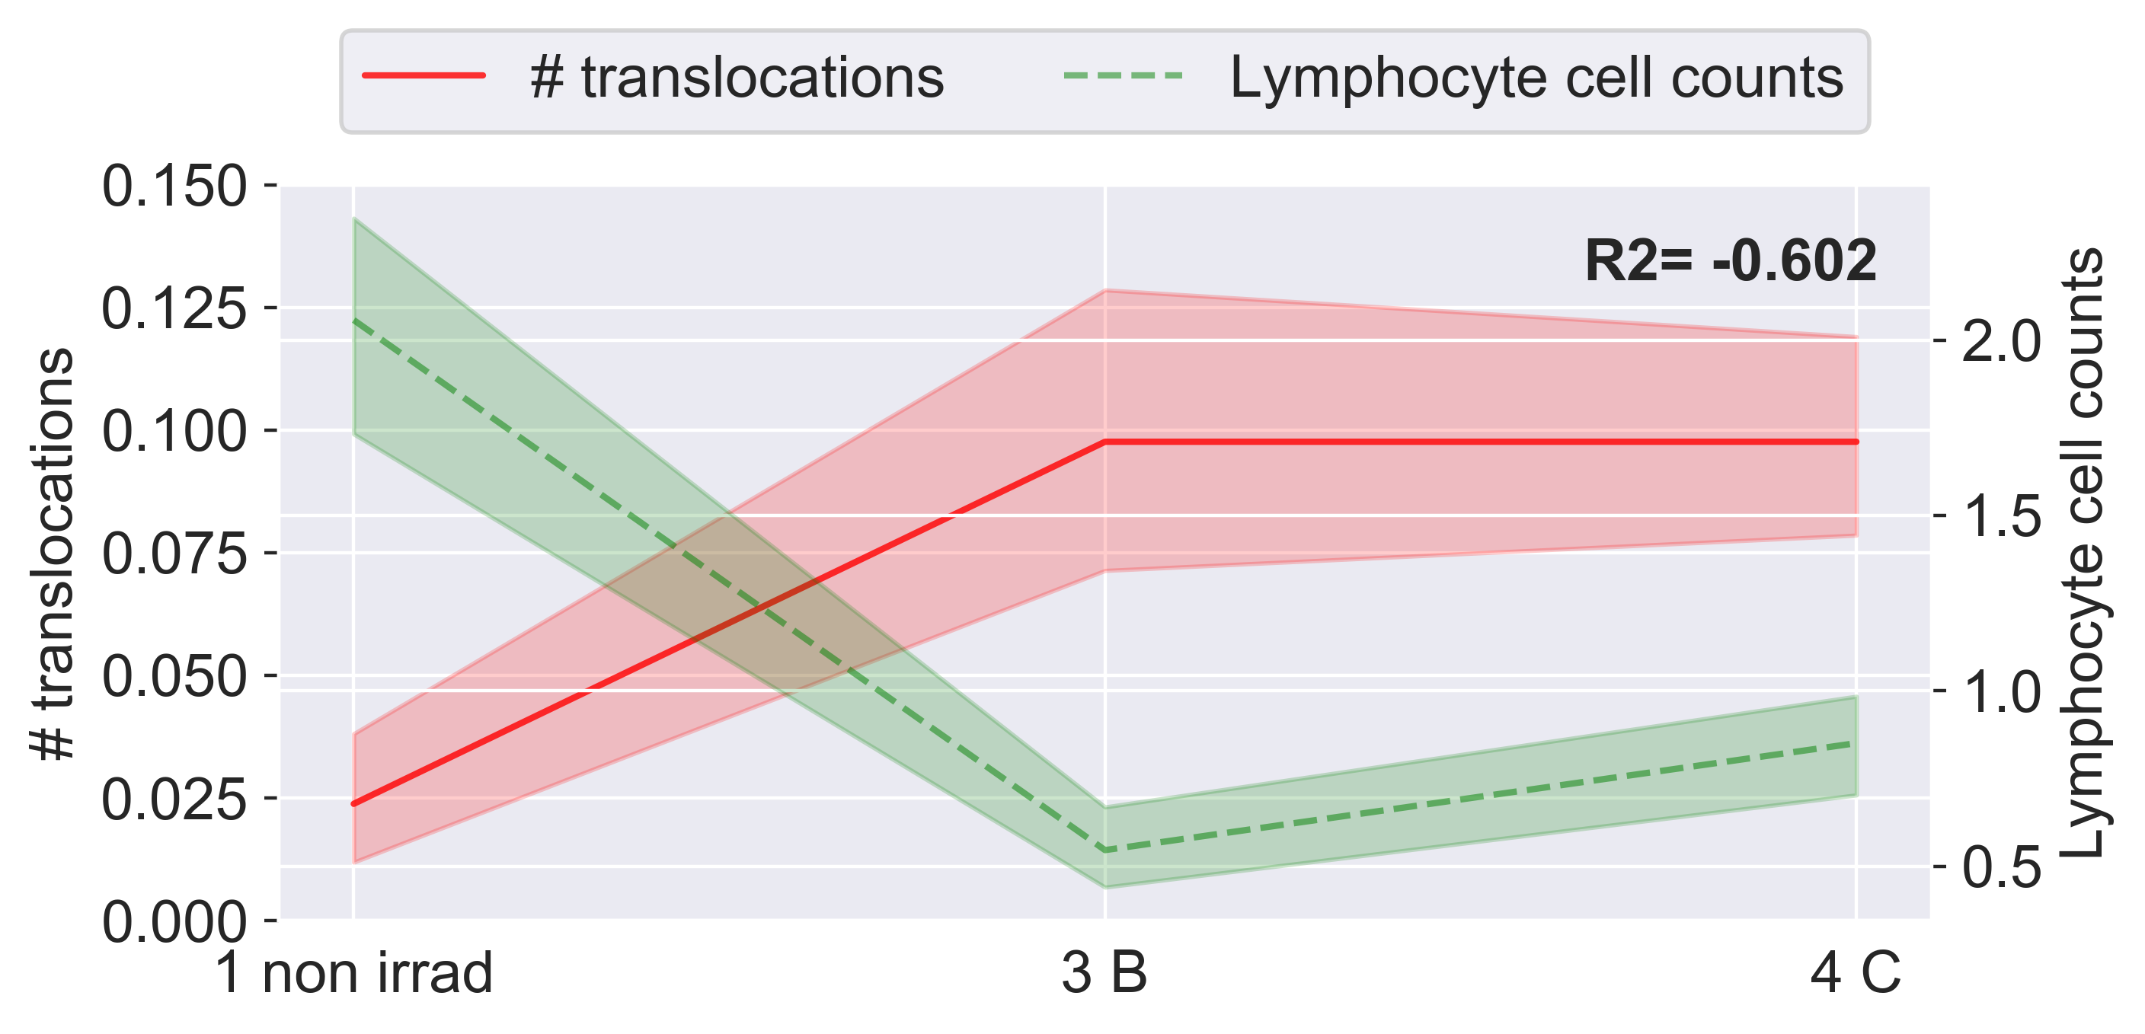
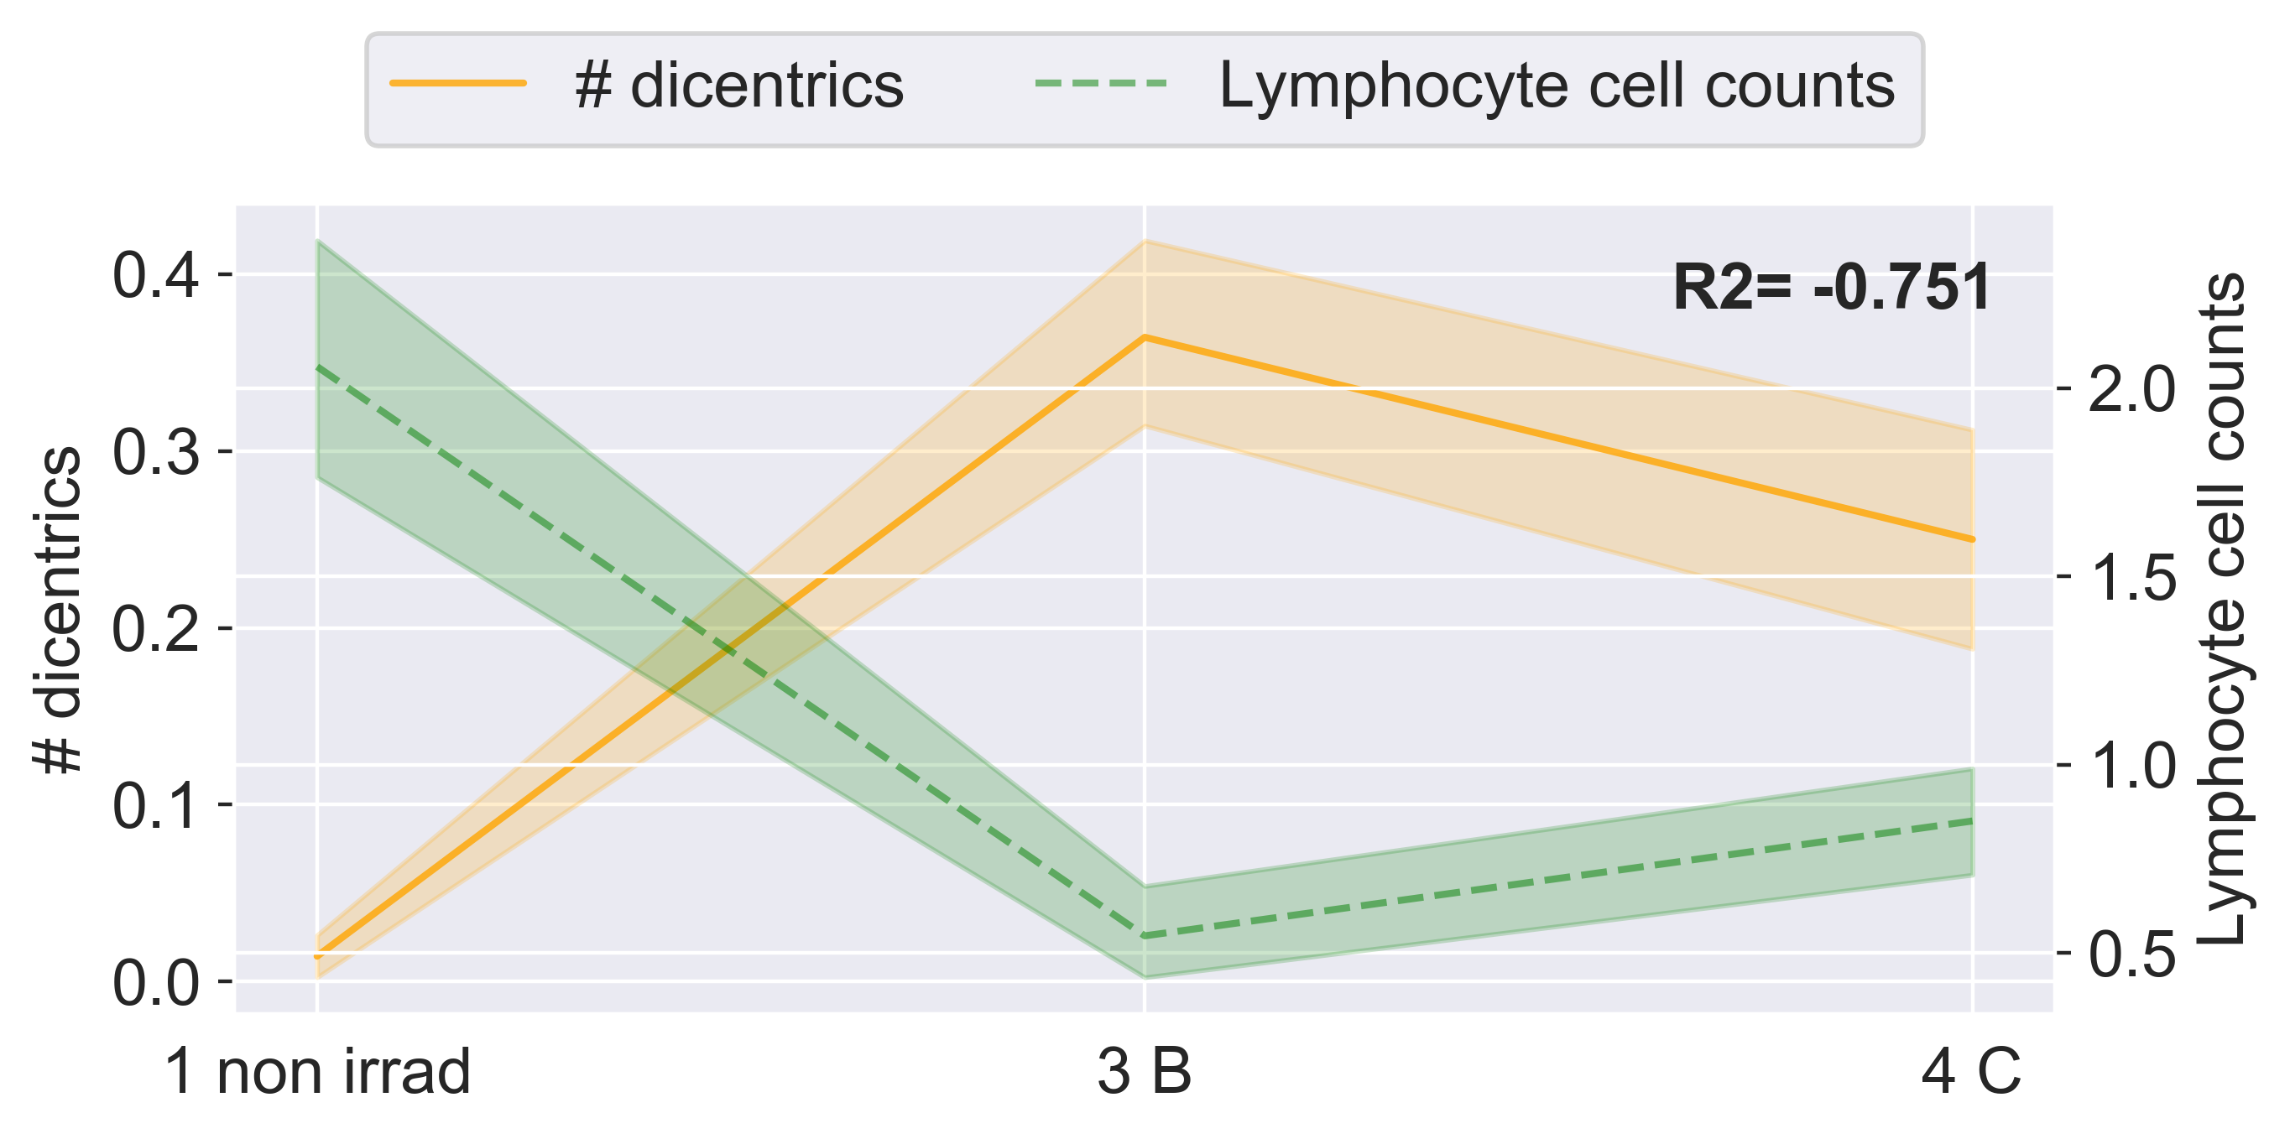
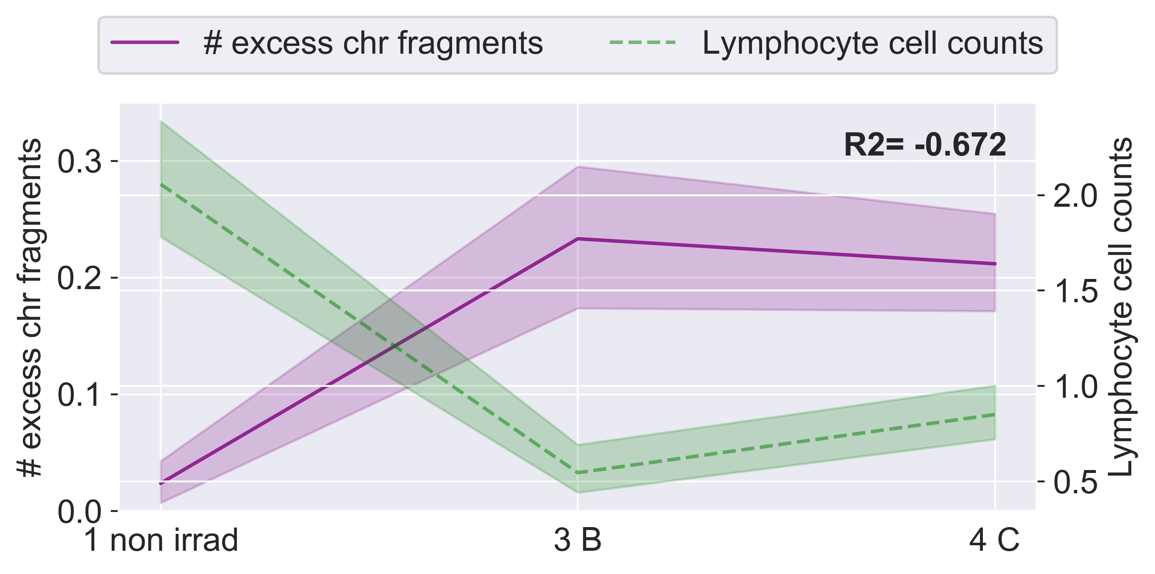
A
B
C
D
Notes:
SUPPLEMENTARY Fig 2 Longitudinal correlations between chromosome aberrations and and peripheral blood lymphocytes during IMRT. Average frequencies of chromosome aberrations plotted longitudinally against lymphocyte cell counts (thousands per microliter) from complete blood count tests for all patients. 1 non irrad: pre-therapy non-irradiated; 3 B: immediate post-therapy; 4 C: 3 months post-therapy. Excess chr fragments: counts of chromosome fragments per cell after subtracting 1 count per n observed dicentrics. Center lines denote medians, lighter bands denote confidence intervals. Pearson correlation R2 values were calculated between plotted values on a per patient basis and noted in bold on each graph. (A) Inversions, (B) translocations, (C) dicentrics, (D) chromosome fragments and lymphocyte cell counts.

Slide 3
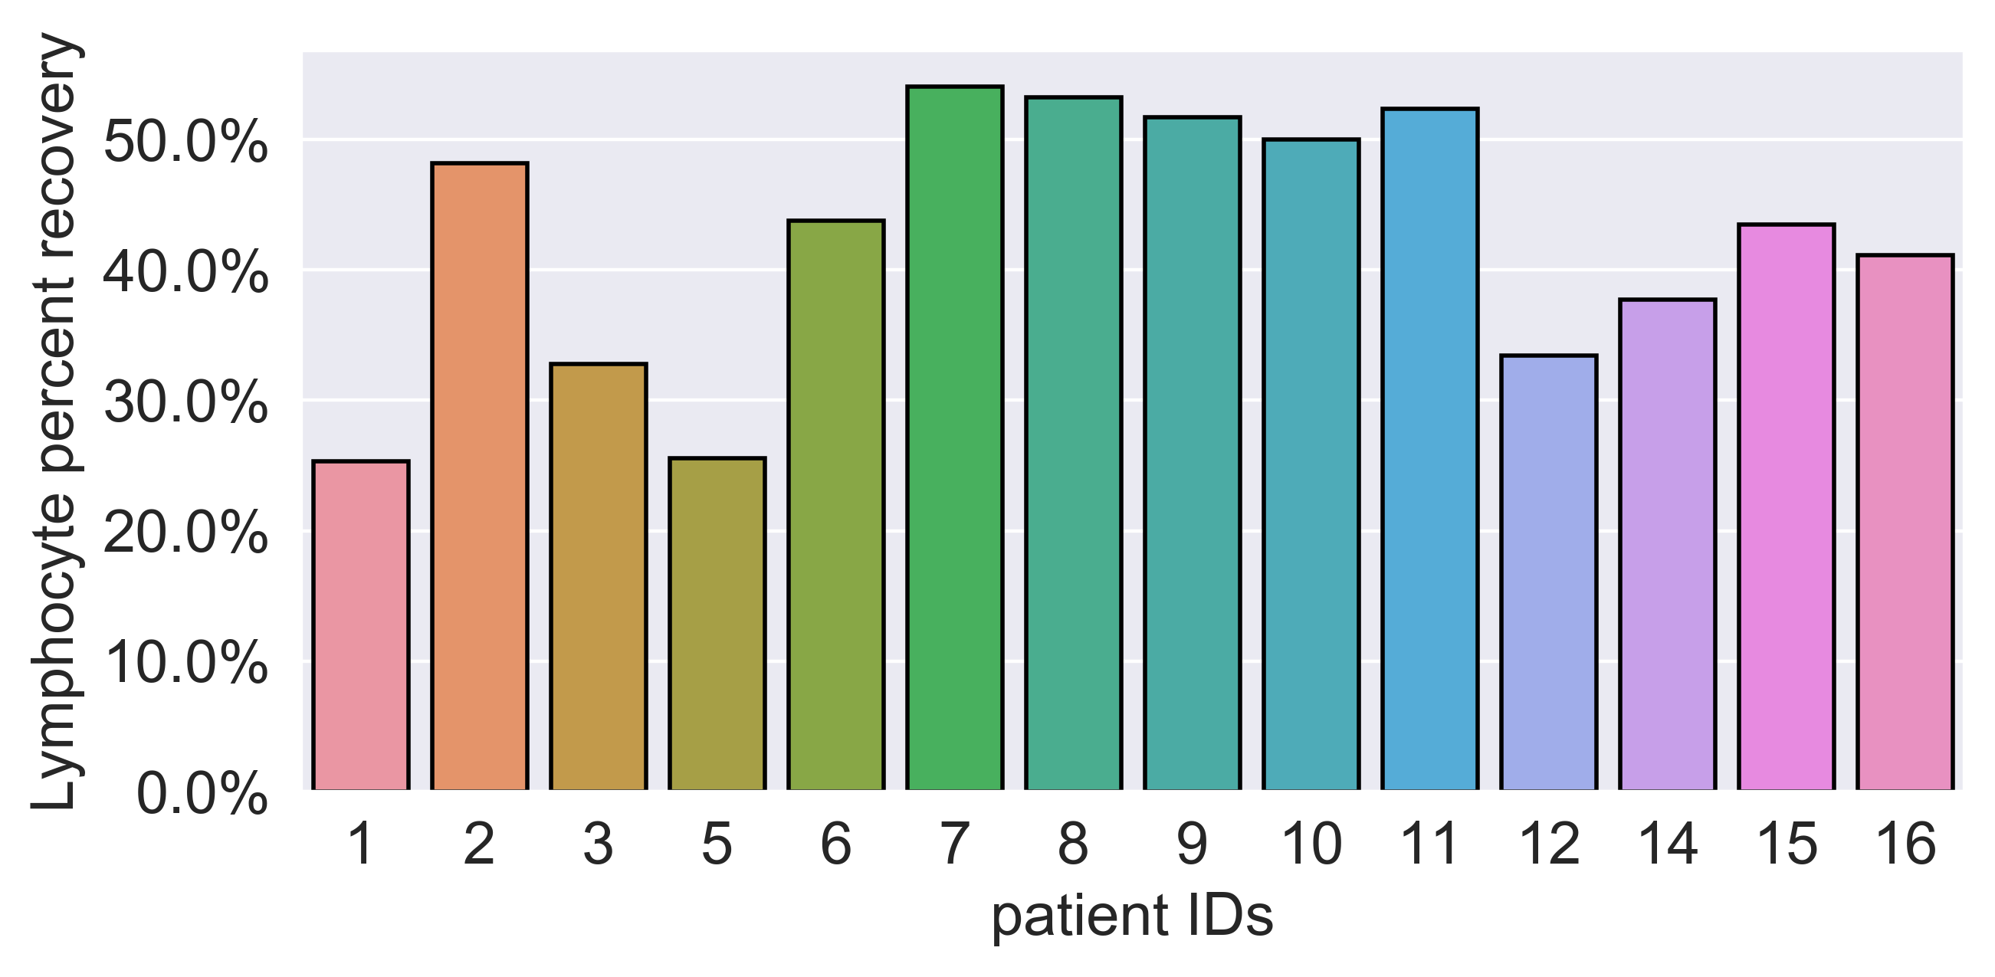
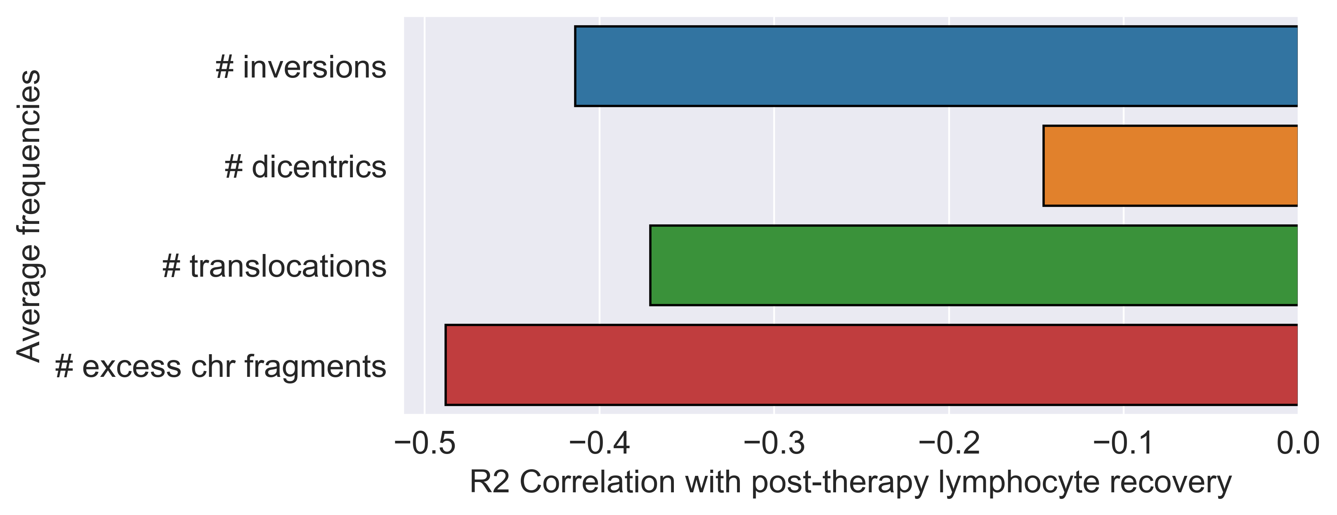
A
B
Notes:
INFORMATIONAL: (A) Percent recovery of lymphocytes (LYM) at post-therapy (pre-therapy LYM count / post-therapy x 100%). (B) Pearson R2 correlation values between post-therapy frequencies of chromosome aberrations and percent recovery of LYM. Correlations were performed on a per patient basis.

Slide 4
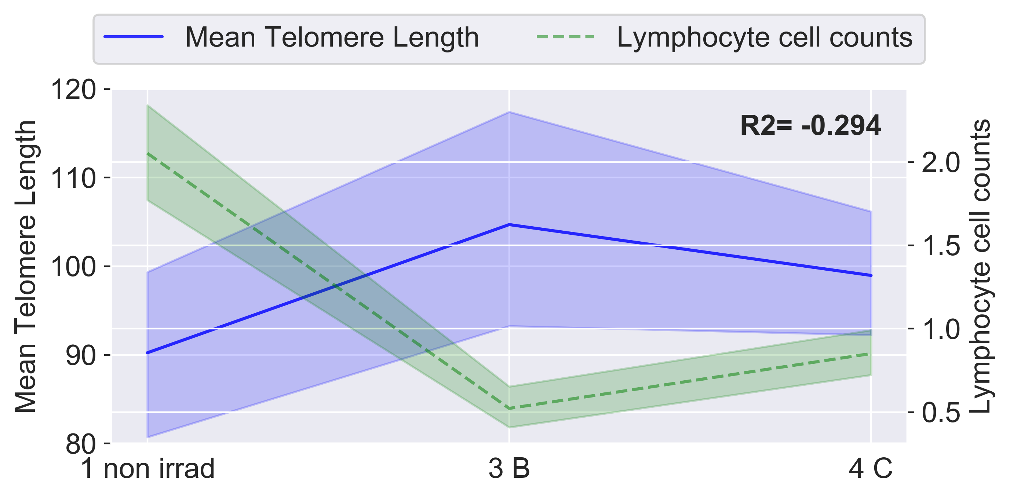
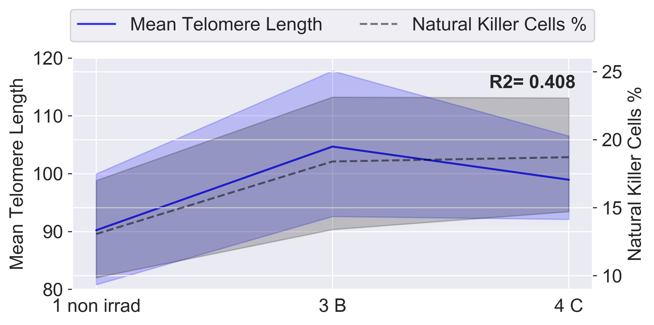
A
B
C
D
E
F
Notes:
PREVIOUS GRAPH VERSION: SUPPLEMENTARY Fig X. Longitudinal relationships between telomere length, chromosome aberrations, and peripheral blood lymphocytes. Mean telomere length and average frequencies of chromosome aberrations plotted longitudinally against lymphocyte cell counts (LYM), and mean telomere length plotted longitudinally against natural killer cells (% of total lymphocytes) from complete blood count tests for all patients. 1 non irrad: pre-therapy non-irradiated; 3 B: immediate post-therapy; 4 C: 3 months post-therapy. Excess chr fragments: counts of chromosome fragments per cell after subtracting 1 count per n observed dicentrics. Center lines denote medians, lighter bands denote confidence intervals. Pearson correlation R2 values were calculated between plotted values on a per patient basis and noted in bold on each graph. Mean telomere length with LYM (A) and natural killer cells % (B). Inversions (C), translocations (D), dicentrics (E), chromosome fragments (F) and LYM.

